Slide 1
Classical Problems of Synchronization
Bounded-Buffer Problem
Readers and Writers Problem
Dining-Philosophers Problem

Slide 2
Bounded-Buffer Problem
Shared data semaphore full, empty, mutex; Initially: full = 0, empty = n, mutex = 1

Slide 3
Bounded-Buffer Problem Producer Process
do {
…
produce an item in nextp
…
wait(empty);
wait(mutex);
…
add nextp to buffer
…
signal(mutex);
signal(full);
} while (1);

Slide 4
Bounded-Buffer Problem Consumer Process
do {
wait(full)
wait(mutex);
…
remove an item from buffer to nextc
…
signal(mutex);
signal(empty);
…
consume the item in nextc
…
} while (1);

Slide 5
Readers-Writers Problem
Shared data semaphore mutex, wrt; Initially mutex = 1, wrt = 1, readcount = 0

Slide 6
Readers-Writers Problem Writer Process
wait(wrt);
…
writing is performed
…
signal(wrt);

Slide 7
Readers-Writers Problem Reader Process
wait(mutex);
readcount++;
if (readcount == 1)
wait(wrt);
signal(mutex);
…
reading is performed
…
wait(mutex);
readcount--;
if (readcount == 0)
signal(wrt);
signal(mutex);

Slide 8
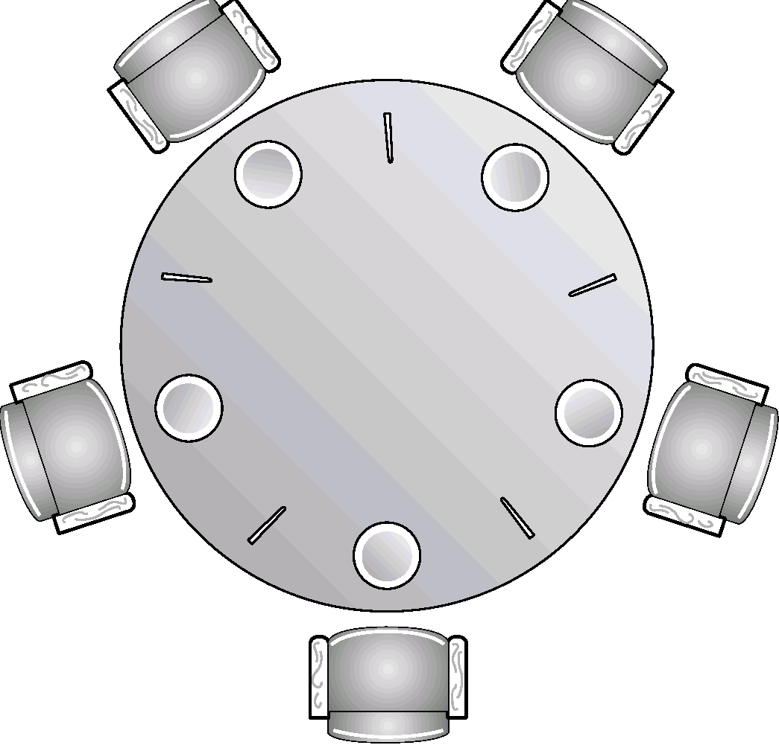
Dining-Philosophers Problem
Shared data
semaphore chopstick[5];
Initially all values are 1

Slide 9
Dining-Philosophers Problem
Philosopher i:
do {
wait(chopstick[i])
wait(chopstick[(i+1) % 5])
…
eat
…
signal(chopstick[i]);
signal(chopstick[(i+1) % 5]);
…
think
…
} while (1);

